Slide 1

Test Scenarios and Test Cases

Slide 2

Test Scenarios
A Test Scenario is defined as any functionality that can be tested.
Test Scenario gives a high-level idea of what we need to test.
Summary of Test cases in one line statement

Slide 3


Test Scenarios for Login page
Example of Test Scenario
Check system behavior when valid email id and password is entered.
Check system behavior when invalid email id and valid password is entered.
Check system behavior when valid email id and invalid password is entered.
Check system behavior when invalid email id and invalid password is entered.
Check system behavior when email id and password are left blank and Sign in entered.
Check Forgot your password is working as expected
Check system behavior when “Keep me signed” is checked

Slide 4

Test Cases
A Test Case is a set of actions executed to verify a particular feature or functionality of your software
A Test Case contains test steps, test data, precondition, and postcondition developed for a specific test scenario to verify any requirement.

Slide 5



The format For Standard Test Cases
Test Case Description
Test Steps
Test Data
Expected Results

Slide 6
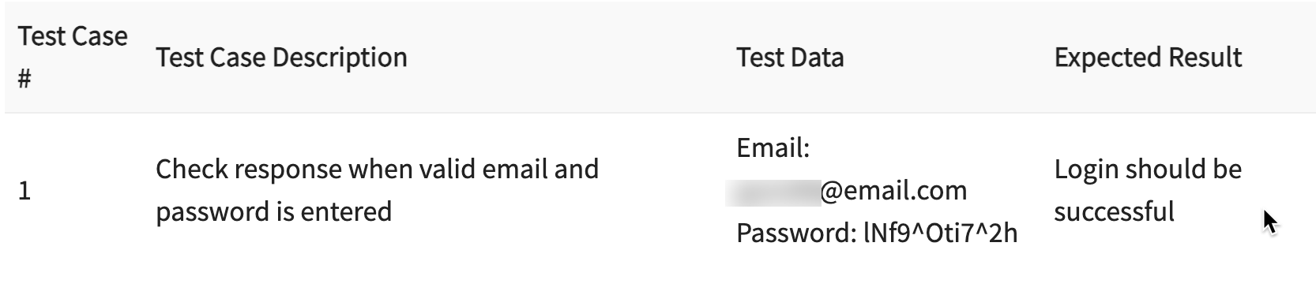

Slide 7
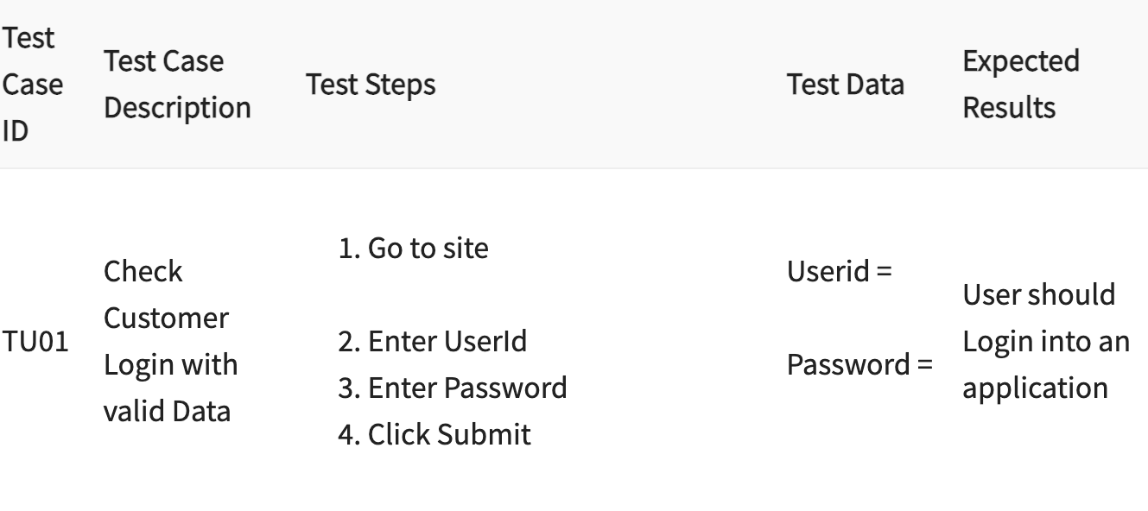

Slide 8
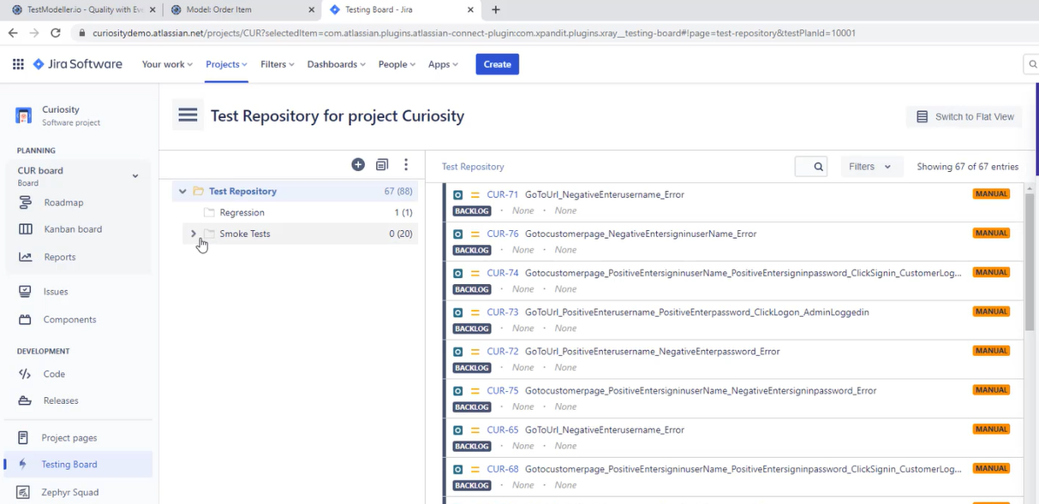

Slide 9
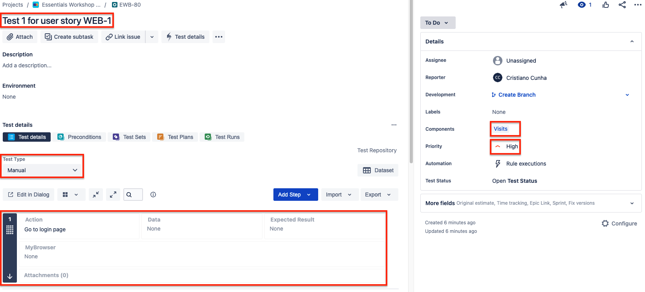

Slide 10


Slide 11
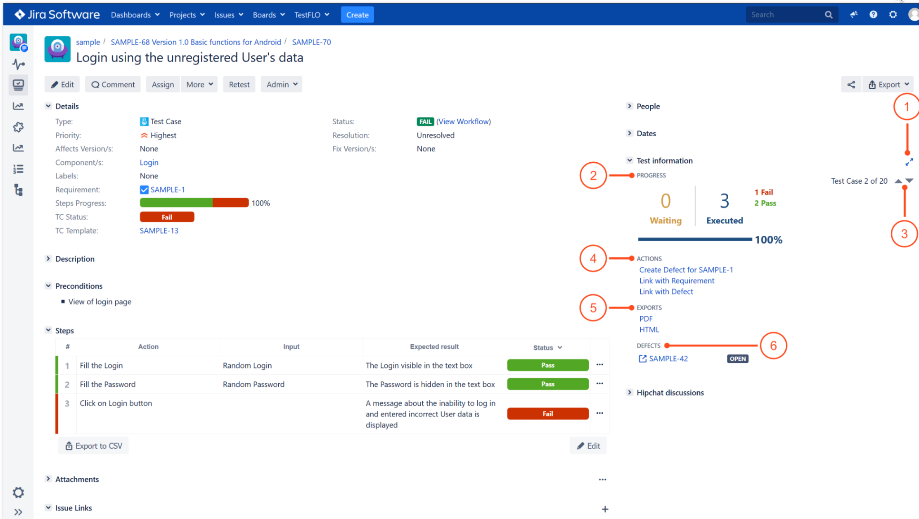

Slide 12
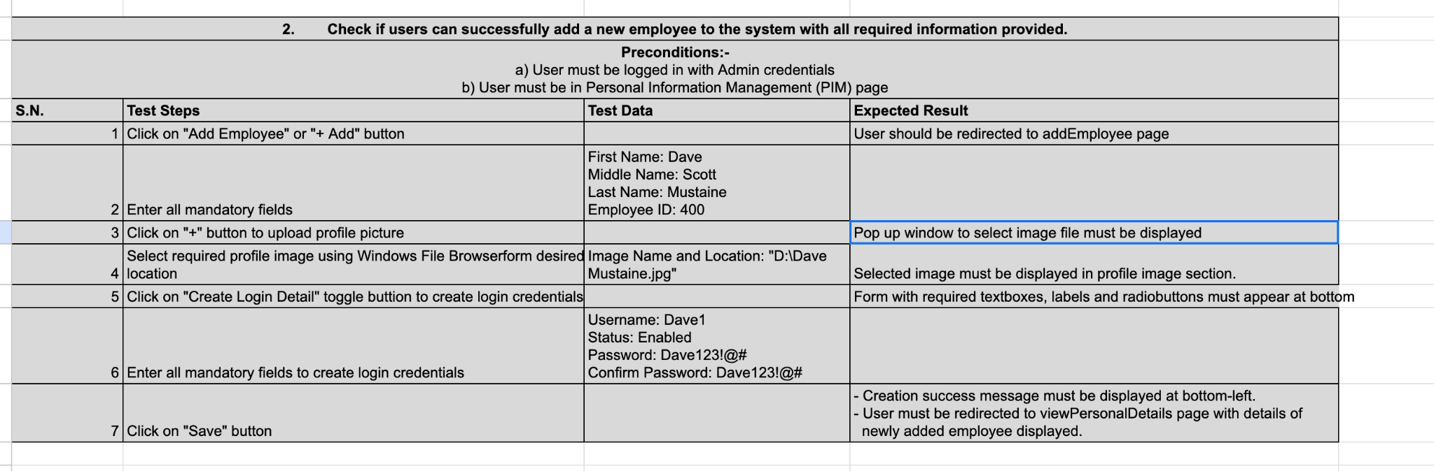
Test Case Sample From Students

Slide 13
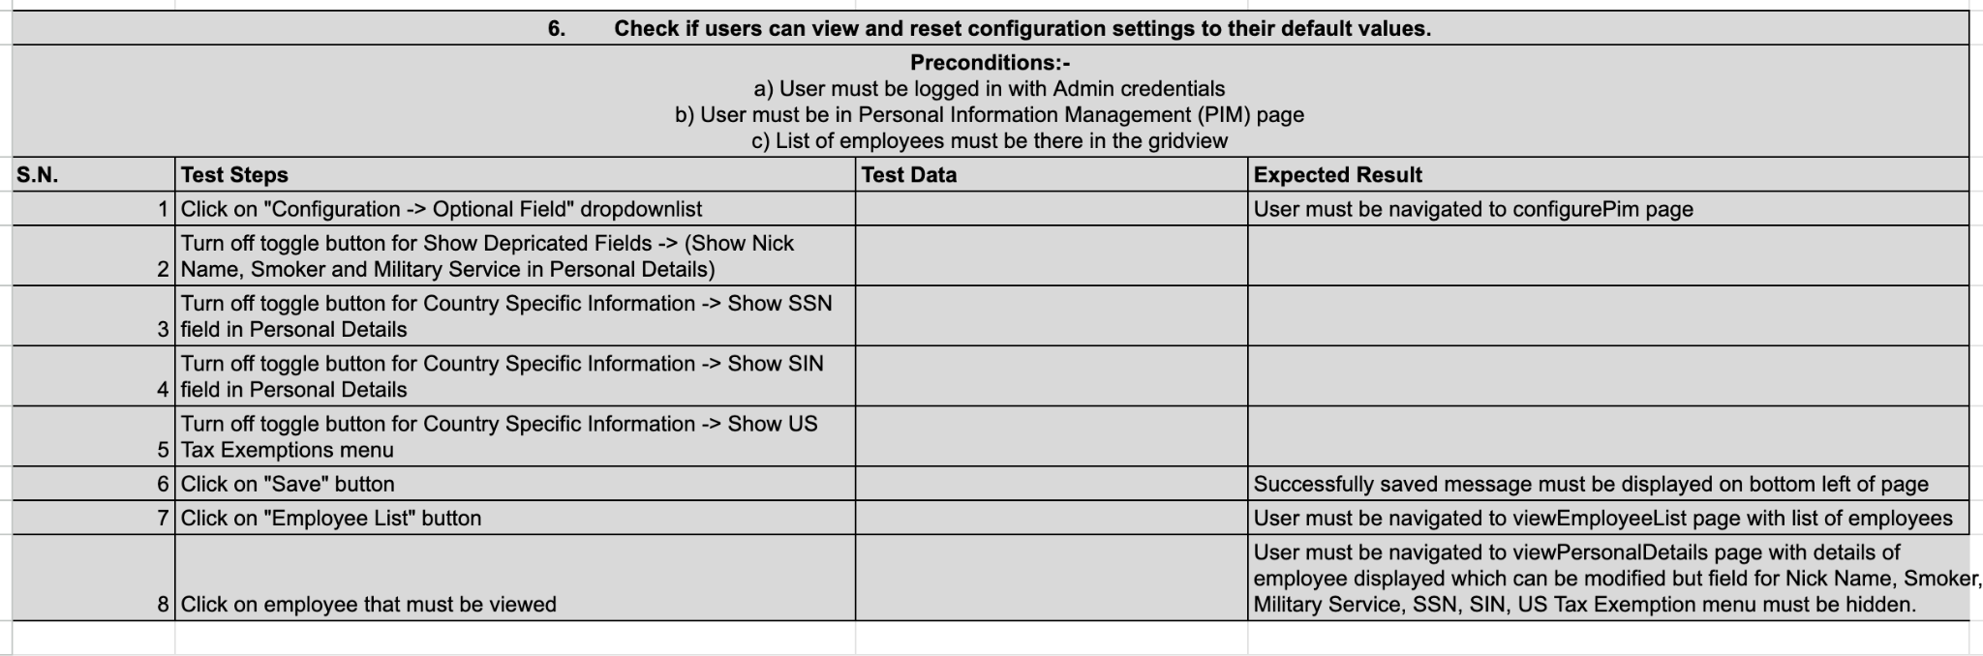
Test Case Sample From Students

Slide 14
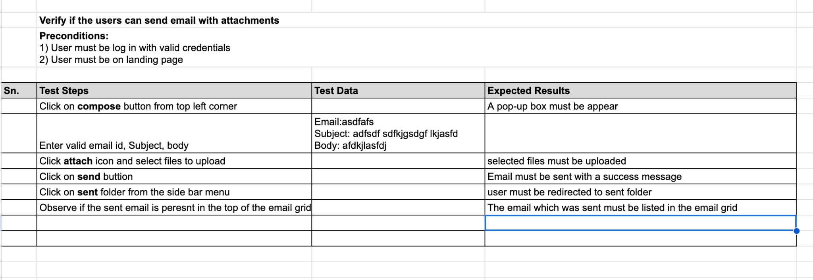
Test Case Sample From Students

